Slide 1
CT TECHNIQUE OF PNS
Dr.Hayam Abdelmonsif

Slide 2
What is CT (Computed Tomography) of the Sinuses?
Computed tomography, more commonly known as a CT scan, is a diagnostic medical test that, like traditional x-rays, produces multiple images or pictures of the inside of the body.
The cross-sectional images generated during a CT scan can be reformatted in multiple planes, and can even generate three-dimensional images. These images can be viewed on a computer monitor, printed on film or transferred to a CD or DVD.

Slide 3
Computed Tomography (CT) - Sinuses
Computed tomography (CT) of the sinuses uses special x-ray equipment to evaluate the paranasal sinus cavities – hollow, air-filled spaces within the bones of the face surrounding the nasal cavity.

Slide 4
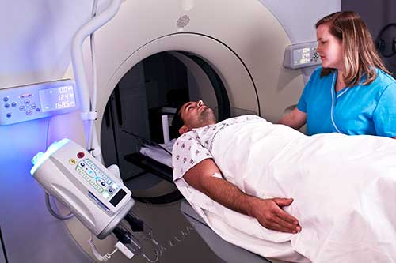

Slide 5
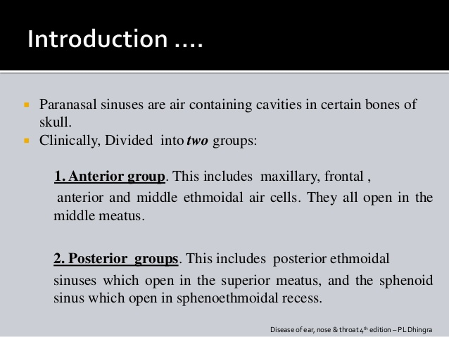

Slide 6
What are some common uses of the procedure?
CT of the sinuses is primarily used to:
Help diagnose sinusitis.
Detect the presence of other inflammatory diseases.
Provide additional information about tumors of the nasal cavity and sinuses.
Plan for surgery by defining anatomy.

Slide 7
Patient preparation
patient should wear comfortable, loose-fitting clothing. He or she may be given a gown to wear during the procedure.
Metal objects, including jewelry, eyeglasses, dentures and hairpins, may affect the CT images and should be left at home or removed prior to your exam.
The patient may also be asked to remove hearing aids and removable dental work..

Slide 8
The patient will be asked not to eat or drink anything for a few hours beforehand, if contrast material will be used in your exam.
You should ask the patient about all medications and if having any allergies.

Slide 9
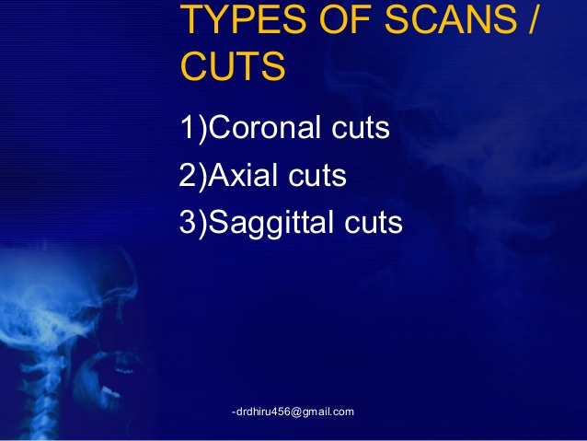

Slide 10
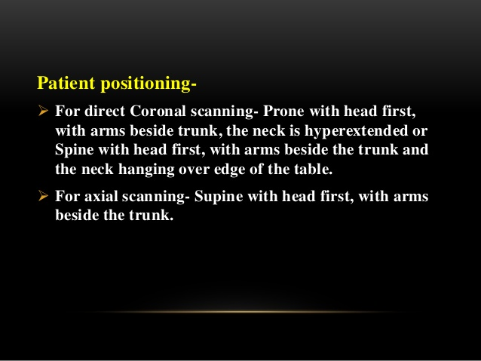

Slide 11
Proper positioning of the patient's head is important to obtain CT images. For axial views, the patient's hard palate is placed perpendicular to the CT scanner table. The images must be captured such that the external auditory canal is in line with the inferior orbital rim. The coronal images are taken so that the gantry is perpendicular to the patient's hard palate. Misalignment or rotation can lead to distortion of the true anatomy on the films.

Slide 12
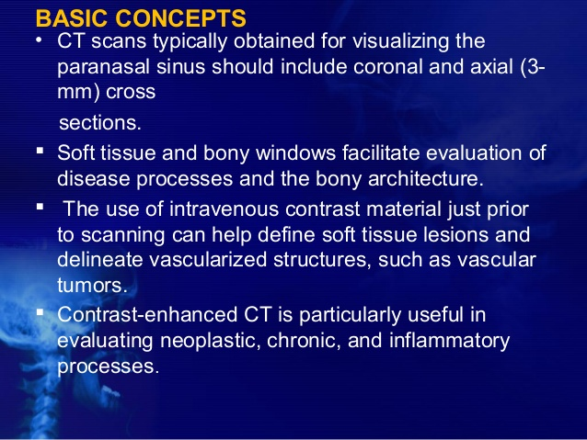

Slide 13
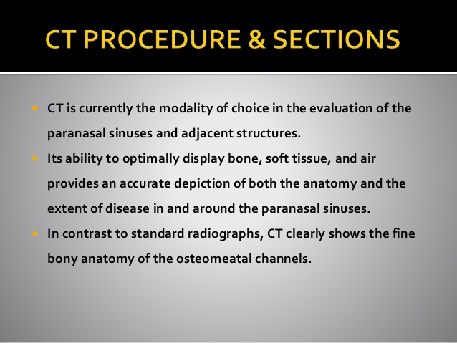

Slide 14
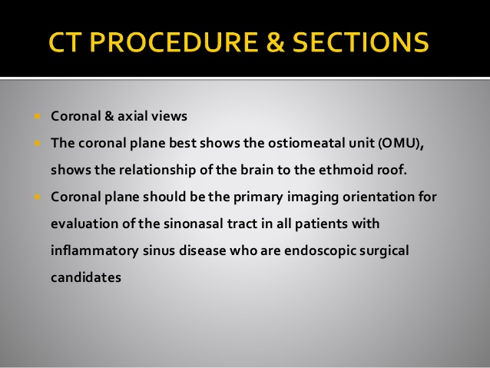

Slide 15
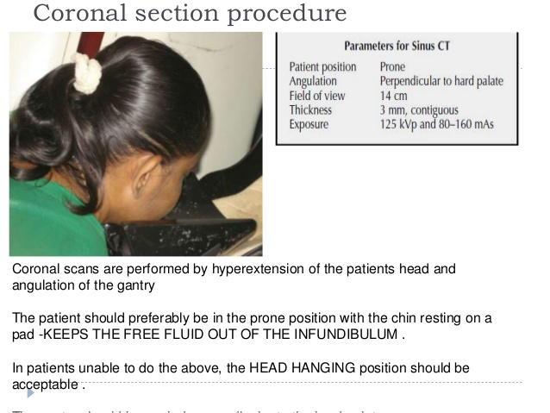

Slide 16
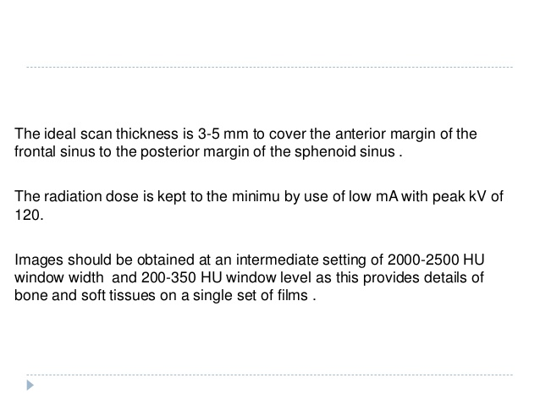

Slide 17
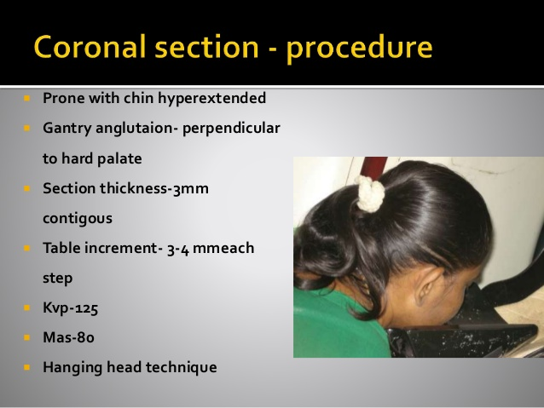

Slide 18
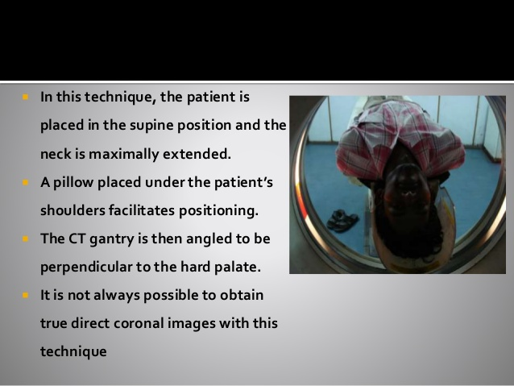

Slide 19
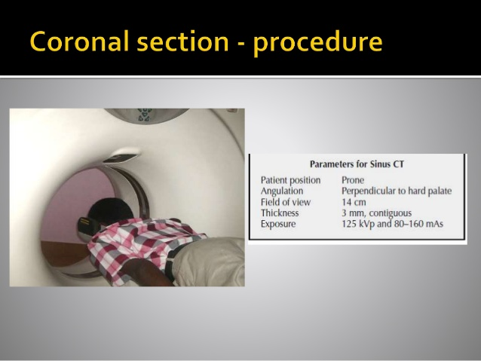

Slide 20
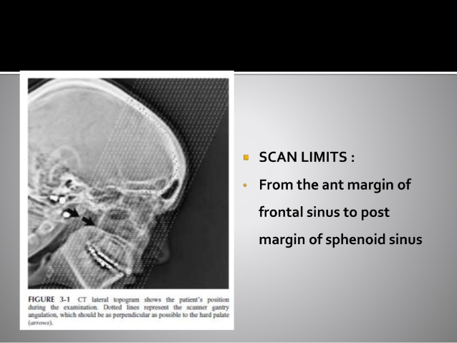

Slide 21
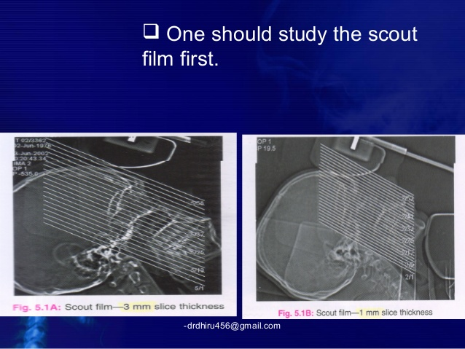

Slide 22
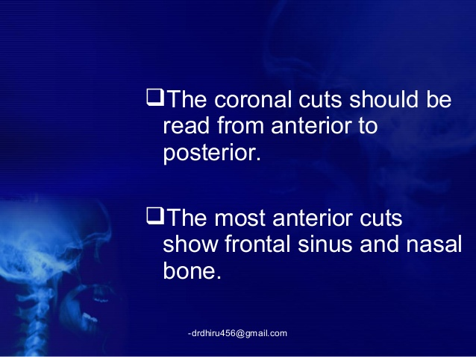

Slide 23
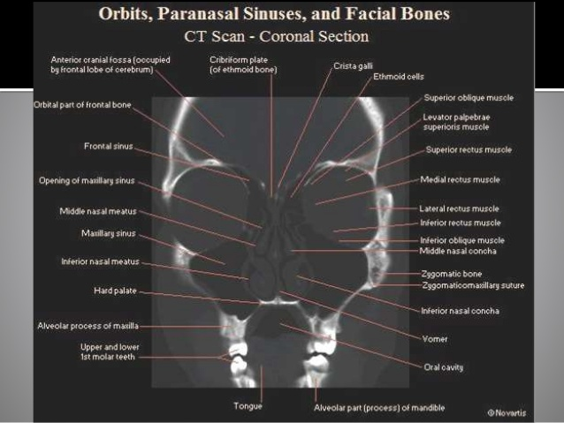

Slide 24
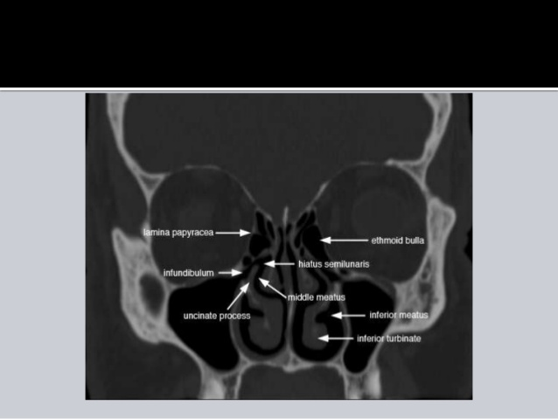

Slide 25
For patients who may not tolerate the prone position required for coronal cuts, computer-generated reconstructed coronal views can be generated from thin axial sections. If sufficiently thin axial sections (1-2 mm) are available, sagittal reconstructions can also be helpful for teaching purposes and further delineating anatomic structures.

Slide 26
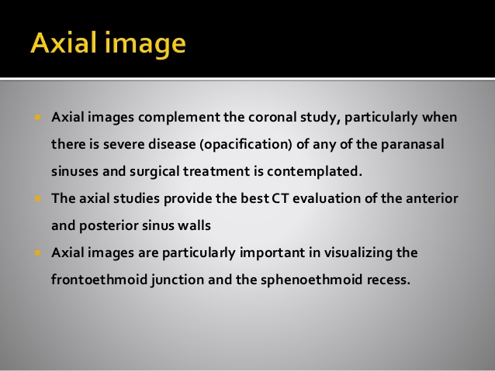

Slide 27
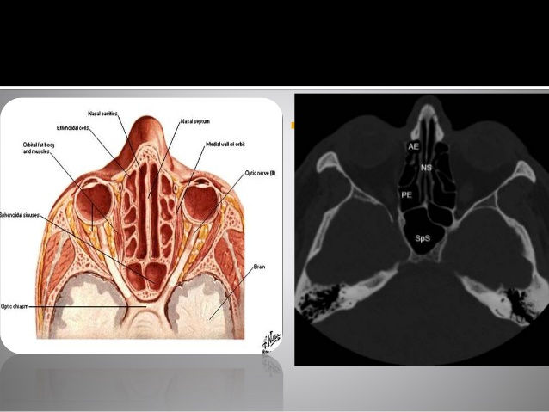

Slide 28
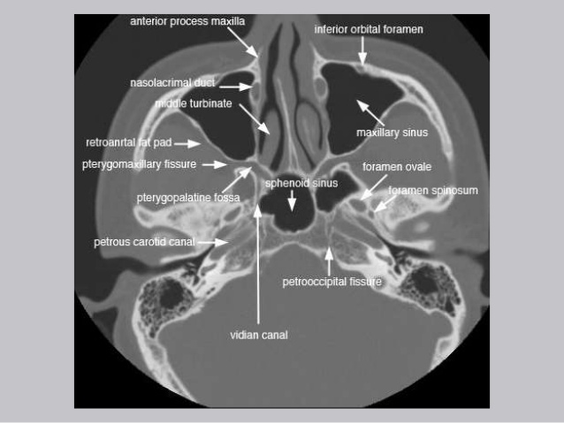

Slide 29
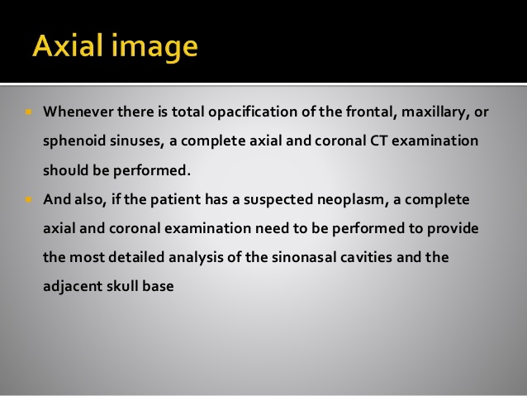

Slide 30
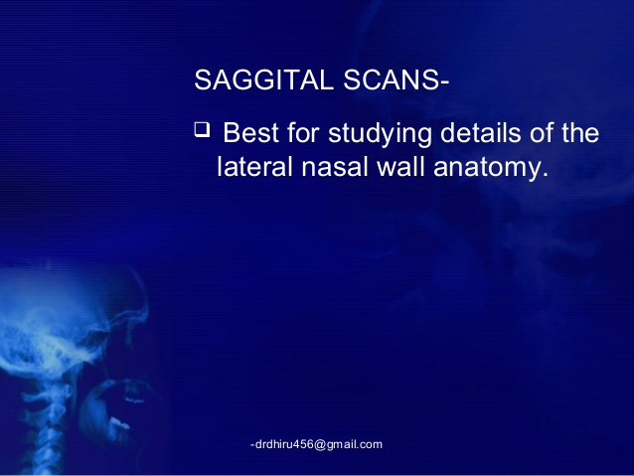

Slide 31
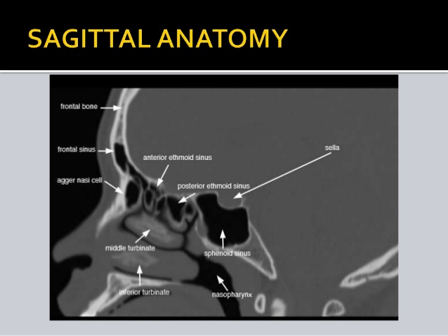

Slide 32
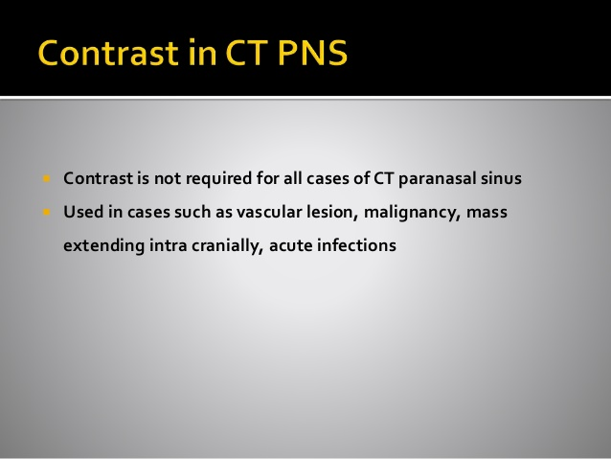

Slide 33
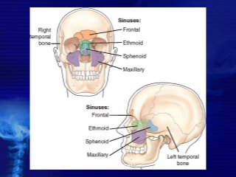

Slide 34
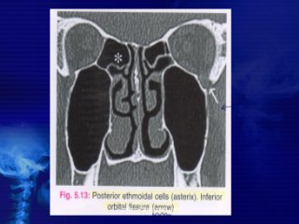

Slide 35
What are the benefits vs. risks?
Benefits
A CT scan is one of the safest means of studying the sinuses.
CT is the most reliable imaging technique for sinusitis.
CT of the sinuses is now widely available and is performed in a relatively short time, especially when compared to magnetic resonance imaging (MRI).
CT scanning is painless, noninvasive and accurate.
A major advantage of CT is its ability to image bone, soft tissue and blood vessels all at the same time.
CT examinations are fast and simple; in emergency cases, they can reveal internal injuries and bleeding quickly enough to help save lives.

Slide 36
CT has been shown to be a cost-effective imaging tool for a wide range of clinical problems.
CT is less sensitive to patient movement than MRI.
CT can be performed if you have an implanted medical device of any kind, unlike MRI.
CT imaging provides real-time imaging, making it a good tool for guiding minimally invasive procedures such as needle biopsies and needle aspirations of many areas of the body, particularly the lungs, abdomen, pelvis and bones.
A diagnosis determined by CT scanning may eliminate the need for exploratory surgery and surgical biopsy.
No radiation remains in a patient's body after a CT examination.
X-rays used in CT scans should have no immediate side effects.

Slide 37
Risks
There is always a slight chance of cancer from excessive exposure to radiation. However, the benefit of an accurate diagnosis far outweighs the risk.
Women should always inform their physician and x-ray or CT technologist if there is any possibility of pregnancy.
Manufacturers of intravenous contrast indicate mothers should not breastfeed their babies for 24-48 hours after contrast medium is given. However, both the American College of Radiology (ACR) and the European Society of Urogenital Radiology note that the available data suggest that it is safe to continue breastfeeding after receiving intravenous contrast.
.

Slide 38
The risk of serious allergic reaction to contrast materials that contain iodine is extremely rare, and radiology departments are well-equipped to deal with them.
Because children are more sensitive to radiation, they should have a CT exam only if it is essential for making a diagnosis and should not have repeated CT exams unless absolutely necessary. CT scans in children should always be done with low-dose technique

Slide 39
What are the limitations of CT of the Sinuses?
CT is usually the first test ordered when a sinus tumor is suspected. If additional information is needed to determine the extent of soft tissue of the tumor, magnetic resonance imaging (MRI) may be helpful.
A person who is very large may not fit into the opening of a conventional CT scanner or may be over the weight limit.

